Slide 1
MALIGNANT COMMENTS CLASSIFIER USING NLP
-Yash Bhardwaj

Slide 2
Outline
Introduction
Exploratory Data Analysis
Data Pre-processing
Word Cloud
Building Models
Conclusion

Slide 3
Introduction
The proliferation of social media enables people to express their opinions widely online. However, at the same time, this has resulted in the emergence of conflict and hate, making online environments uninviting for users. Although researchers have found that hate is a problem across multiple platforms, there is a lack of models for online hate detection.
Online hate, described as abusive language, aggression, cyberbullying, hatefulness and many others has been identified as a major threat on online social media platforms. Social media platforms are the most prominent grounds for such toxic behavior.

Slide 4
There has been a remarkable increase in the cases of cyberbullying and trolls on various social media platforms. Many celebrities and influences are facing backlashes from people and have to come across hateful and offensive comments. This can take a toll on anyone and affect them mentally leading to depression, mental illness, self-hatred and suicidal thoughts.
Internet comments are bastions of hatred and vitriol. While online anonymity has provided a new outlet for aggression and hate speech, machine learning can be used to fight it. The problem we sought to solve was the tagging of internet comments that are aggressive towards other users. This means that insults to third parties such as celebrities will be tagged as un-offensive, but “u are an idiot” is clearly offensive.
Problem Statement:
Our goal is to build a prototype of online hate and abuse comment classifier which can used to classify hate and offensive comments so that it can be controlled and restricted from spreading hatred and cyberbullying.

Slide 5
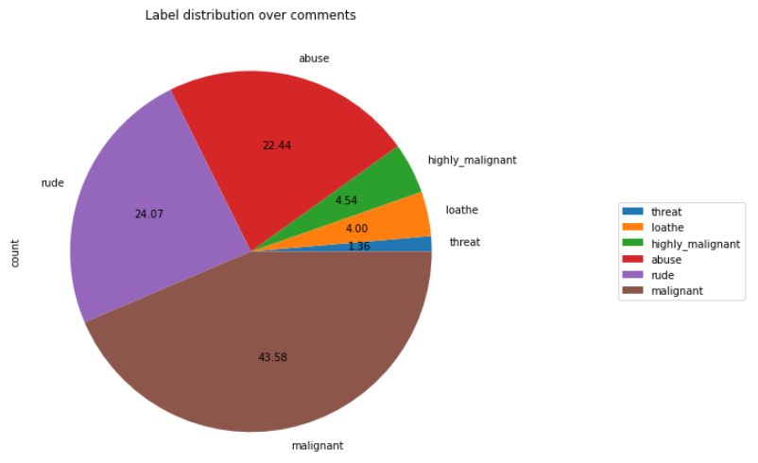
Exploratory Data Analysis
Out of total negative comments around 43.58% are malignant in nature followed by 24.07% are rude comments

Slide 6
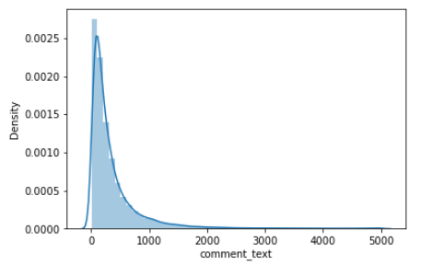
Observation:
Above is a plot showing the comment length frequency. As noticed, most of the comments are short with only a few comments longer than 1000 words.
Majority of the comments are of length 500, where maximum length is 5000 and minimum length is 5. Median length being 250.

Slide 7
Data Pre-processing
Convert the text to lowercase
Remove the punctuations, digits and special characters
Tokenize the text, filter out the adjectives used in the review and create a new column in data frame
Remove the stop words
Stemming and Lemmatising
Applying Text Vectorization to convert text into numeric

Slide 8
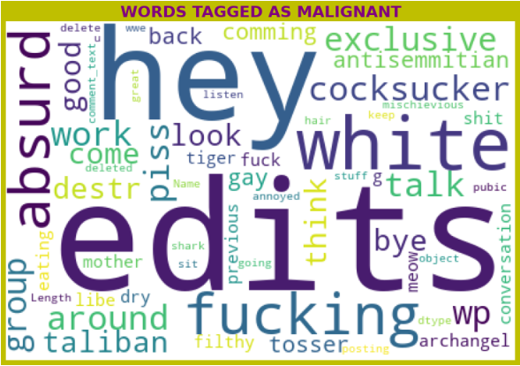
Word Cloud
For malignant comments words like white, edits, absurd seems to be more frequent.

Slide 9
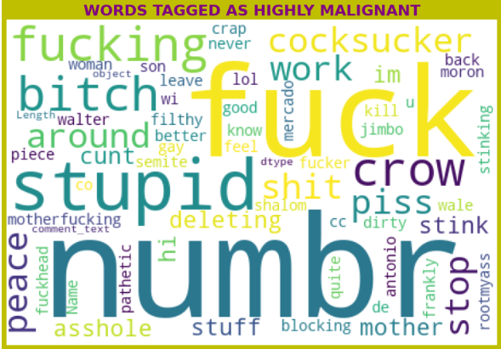
For highly malignant comments words like numbr which was a substitute for all the digits , stupid , fuck etc. are seem to be much more frequent.

Slide 10
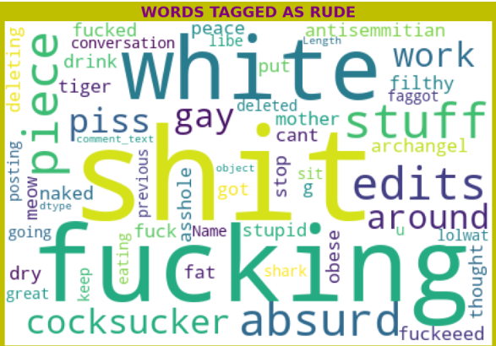
For rude comments words like shit, white, fucking, absurd etc. seems to be more important.

Slide 11
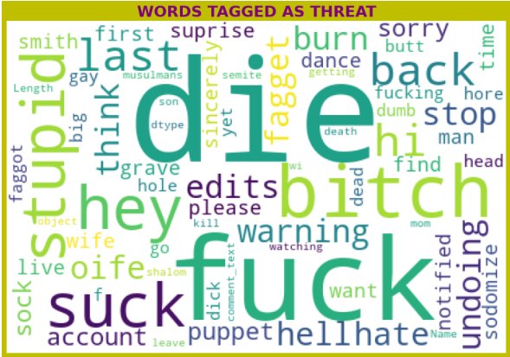
For threat comments words like die, back, suck etc. seems to be more frequent.

Slide 12
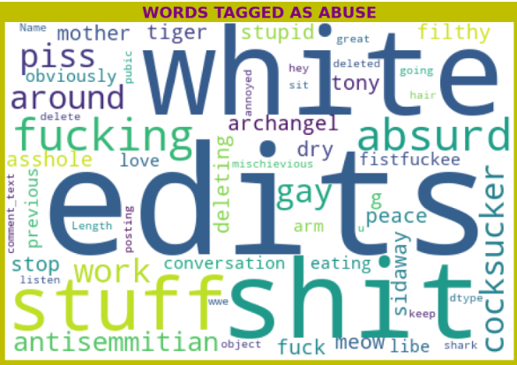
For abuse comments words like white, edits, stuff, shit etc. seems to be more frequent.

Slide 13
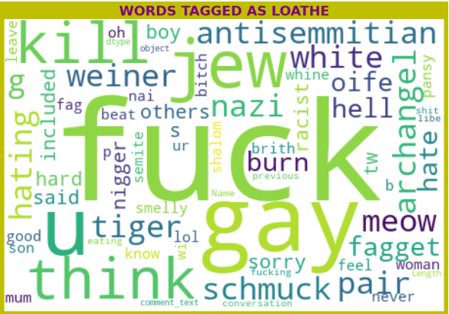
For loathe comments words like fuck, gay, kill, think, jew etc. seems to be more frequent.

Slide 14
Building Models
The different classification algorithm used in this project to build ML model are as below:
Logistic Regression
Support Vector Classifier
XGB Classifier
Ada Boost Classifier

Slide 15

Both support Vector Classifier and XGB Classifier are giving almost same results.
Support Vector Classifier gives maximum Accuracy Score: 91.09 % and Hamming Loss: 2.139% than the other classification models.
Hyper parameter Tuning is perform over this best model using best param shown below :

Slide 16
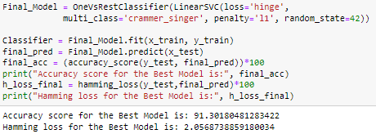
Final Model:
Final Model is giving us Accuracy score of 91.30% which is slightly improved compare to earlier Accuracy score of 91.09%.
The model is working well, we can save it using pickle or joblib.

Slide 17
Conclusion:
Linear Support Vector Classifier performs better with Accuracy Score: 91.09 % and Hamming Loss: 2.139% than the other classification models.
Final Model (Hyperparameter Tuning) is giving us Accuracy score of 91.30% which is slightly improved compare to earlier Accuracy score of 91.09%.
SVM classifier is fastest algorithm compare to others.
The Maximum feature used while vectorization is 2000. Employing more feature in vectorization lead to more accurate model which is limited because of low computational resources.
Data is imbalanced in nature but due to computational limitation we have not employed balancing techniques here.
Deep learning CNN, ANN can be employed to create more accurate model.

